Slide 1
Water Information Management System (WIMS)
National Hydrology Project(NHP)
Ministry of Jal Shakti
Department of Water Resources, RD & GR

Slide 2
Online Training Session Webinar Topic : Telemetry Management in WIMS. How to create telemetry station, sensor/data type mapping and sensor configuration in WIMS?
National Hydrological Project(NHP)
Date of Training : 27-08-2020
Venue: Webinar Organised By : NPMU ,NHP, MOWR,TAMC, CWC
.

Slide 3
Trainer Name : Meet Kumar Agarwal
Designation : Test Lead
Department : TAMC- National Hydrological Project(NHP) Email Id : meetk@tekskillsinc.net Contact No : 9650866776

Slide 4
Welcome Note & WIMS Project Objective
.

Slide 5
WIMS – Water Information Management System
Telemetry Management (INSAT/GPRS)
Sensor Hub Configuration
Create Data logger ID Configuration Add Sensor Configuration Edit Sensor Configuration
Reservoir Sensor Configuration
Create Satellite ID Configuration Add Gates Configuration Edit Gates Configuration

Slide 6
WIMS URL WIMS Application URL- tamcnhp.com/wims/ Or use URL - https://www.indiawris.gov.in

Slide 7
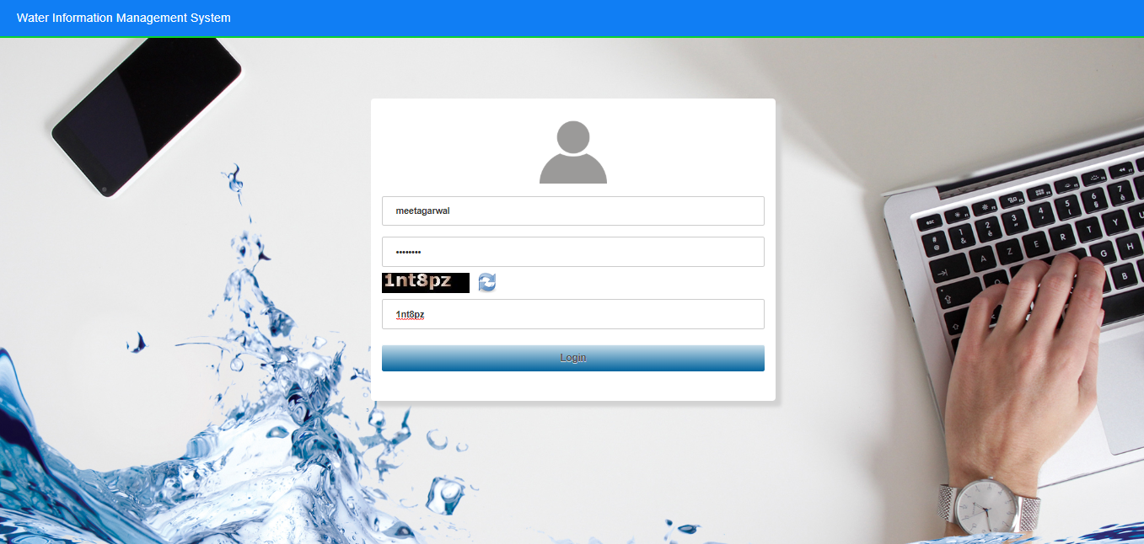
Login into WIMS (Water Information Management System) Enter Login, Password & Captcha details based on the User Agency. Click on Login button

Slide 8
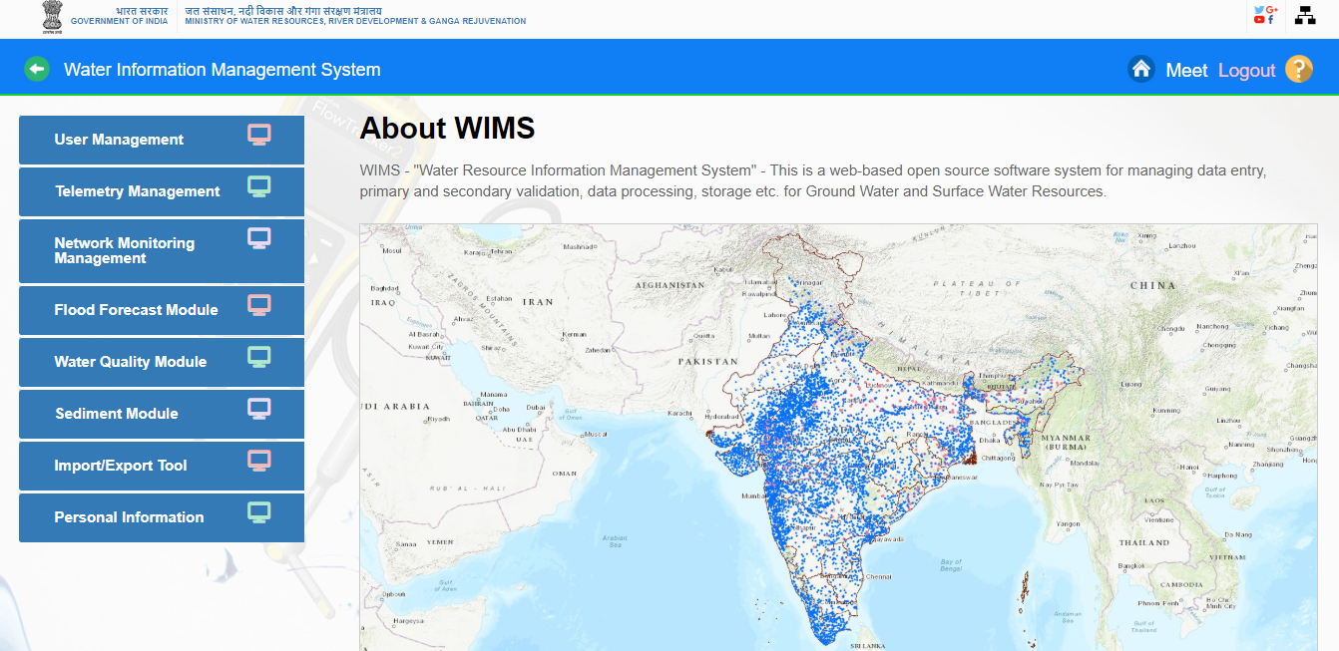
Home page of WIMS will be displayed on screen after login into WIMS application. User once done with the work can logout the session using the Logout Icon on the right top corner. Home Icon is to navigate back to the main page from sub modules page

Slide 9
TELEMETRY MANAGEMENT IN MANAGEMEN

Slide 10
TELEMETRY MANAGEMENT
Sensor Hub Configuration
Reservoir Sensor Hub Configuration
How to create and any telemetric station in Water Resource Management Information System (WIMS) –
-Add /edit stations through Station Management module, define various observation categories (type of sensors) in each station, type of telemetry (INSAT, GPRs)etc.
- Configuration of sensors – assign data loggers, data positions, and calculations/equations required to read the data in system from telemetry management module
There are two authorized users
Agency User – can create station
Vendor – can define sensor configuration
These users can also edit the existing data from their respective access log.

Slide 11
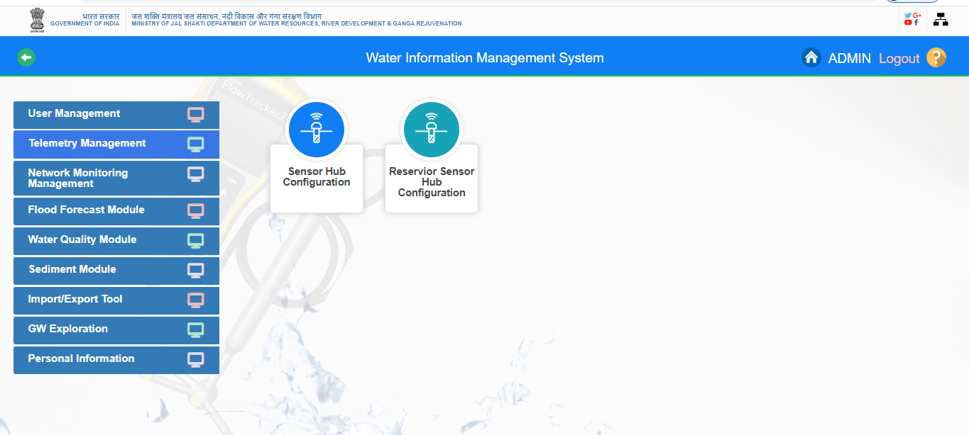
TELEMETRY MANAGEMENT

Slide 12
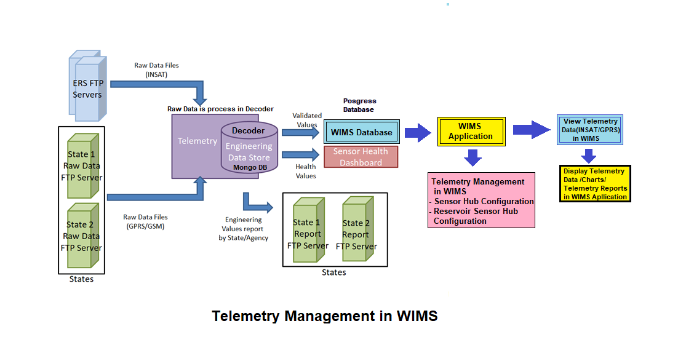
TELEMETRY MANAGEMENT IN WIMS

Slide 13
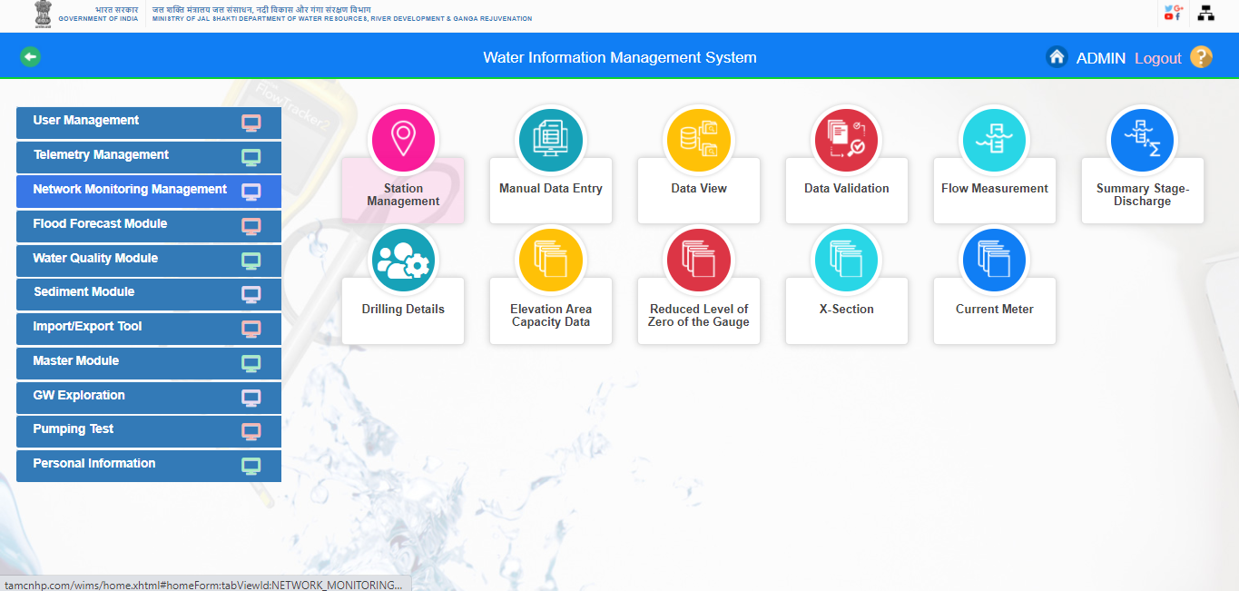
Add/Edit Telemetric Station in WIMS

Slide 14
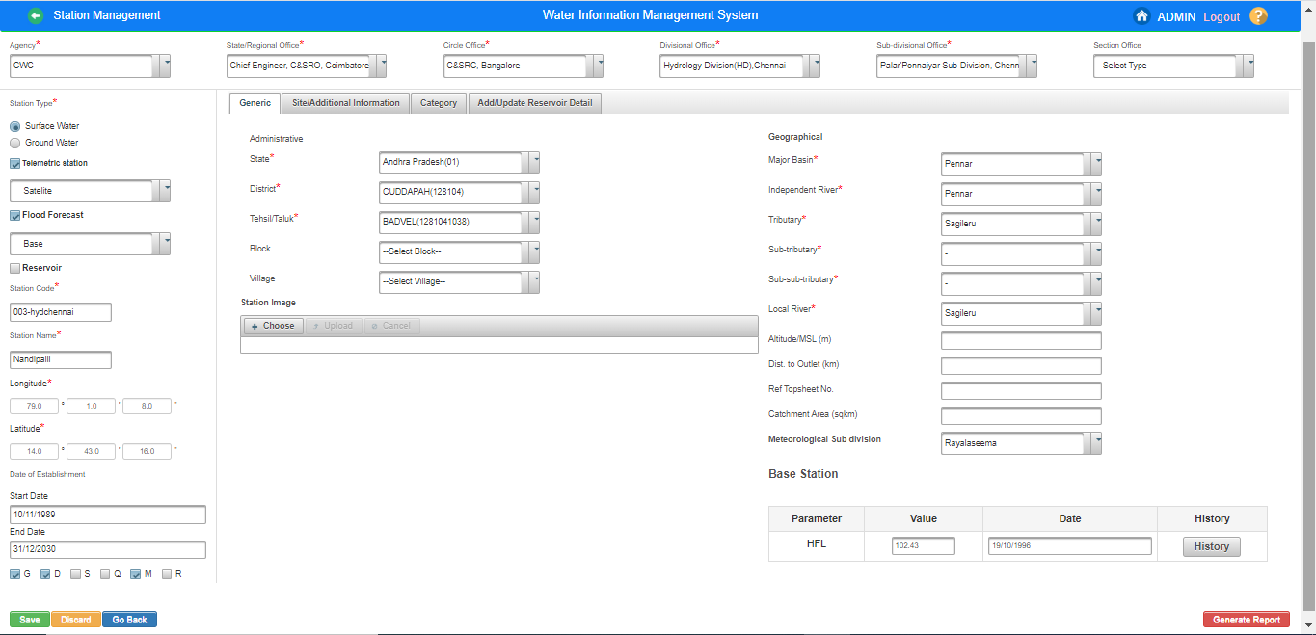
Add/Edit Telemetric Station in WIMS

Slide 15
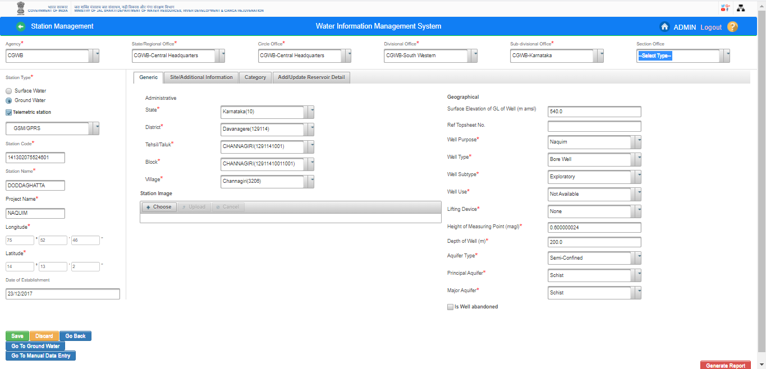

Slide 16
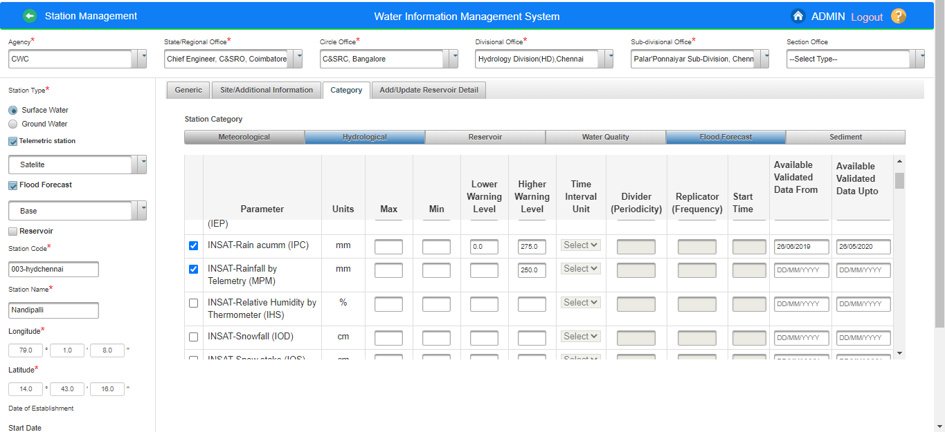
Sensors/ Data Type Mapping

Slide 17
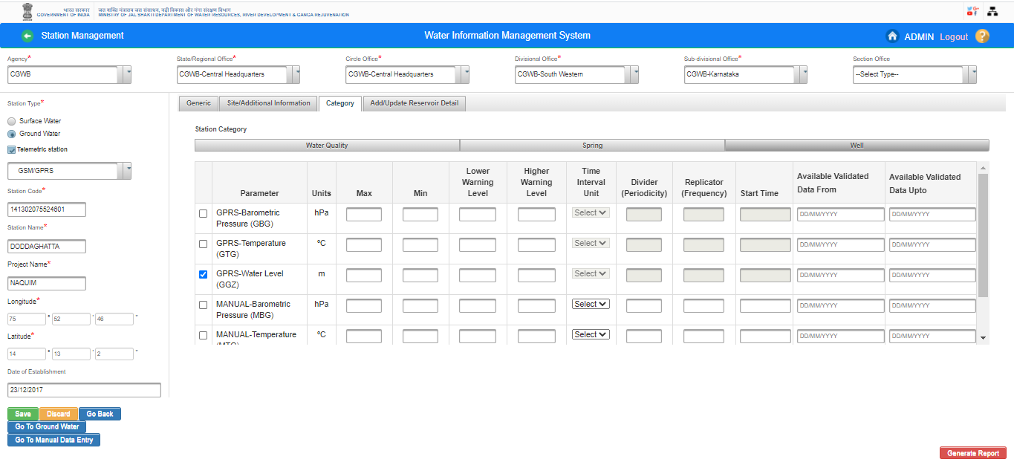

Slide 18
How to configure the sensors on telemetry sites in WIMS ? Sensor Hub Configuration (SW /GW) i) Create Data Logger Configuration ii) Add Sensor Configuration iii) Edit Sensor Configuration

Slide 19
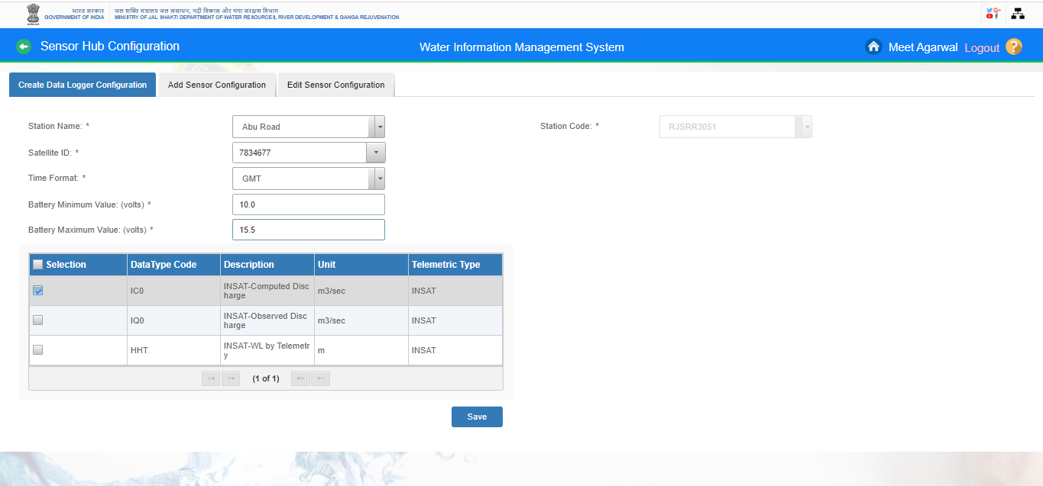
Create Data Logger Configuration

Slide 20
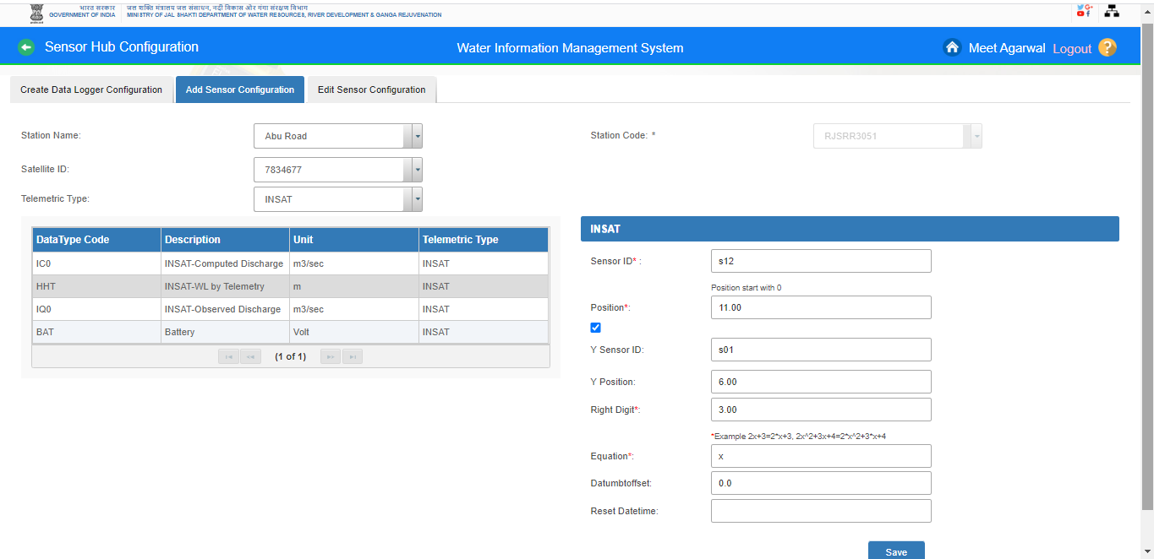
Add Sensor Configuration

Slide 21
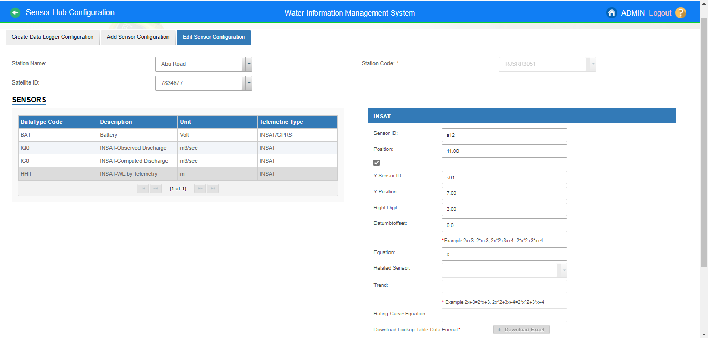
Edit Sensor Configuration

Slide 22
Reservoir Sensor Hub Configuration

Slide 23
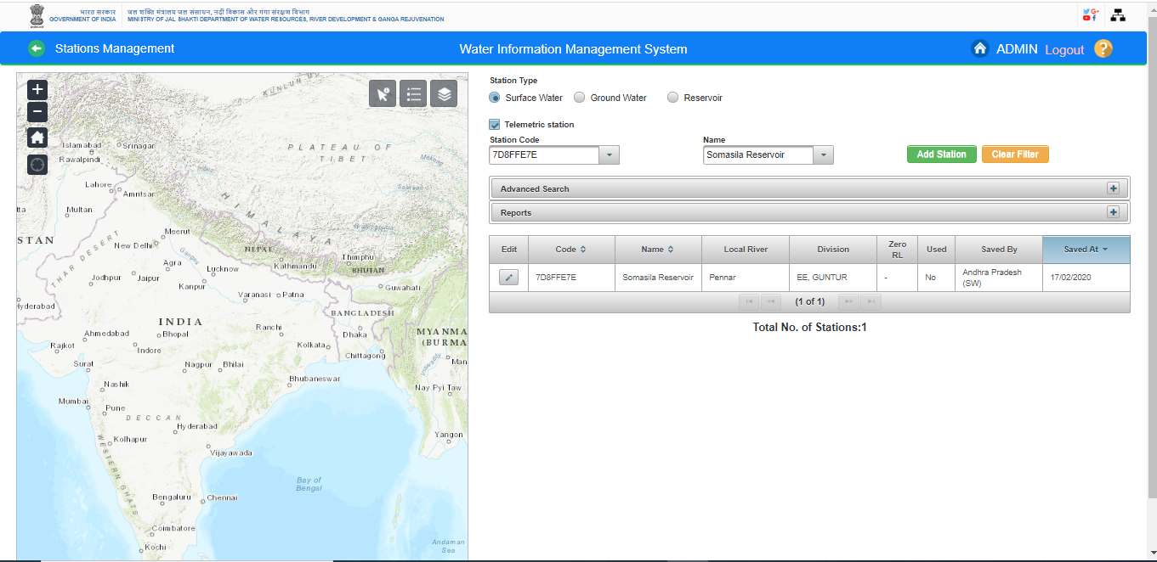
Add /Edit Reservoir Telemetry Station

Slide 24
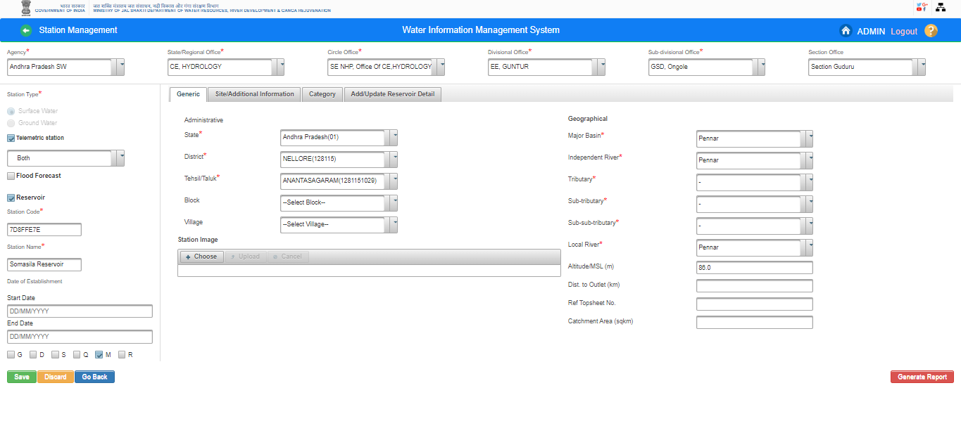
Add /Edit Reservoir Telemetry Station

Slide 25
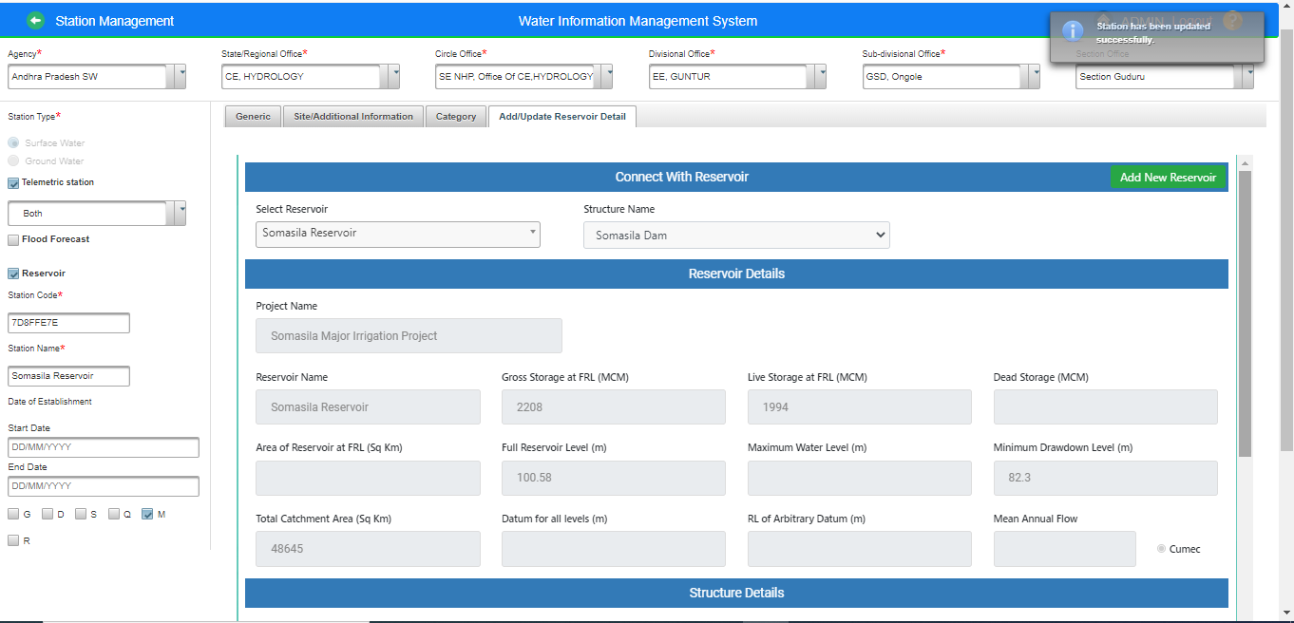

Slide 26
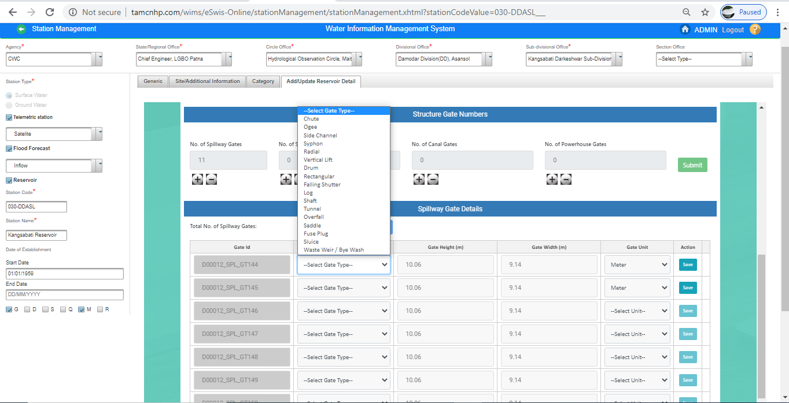

Slide 27
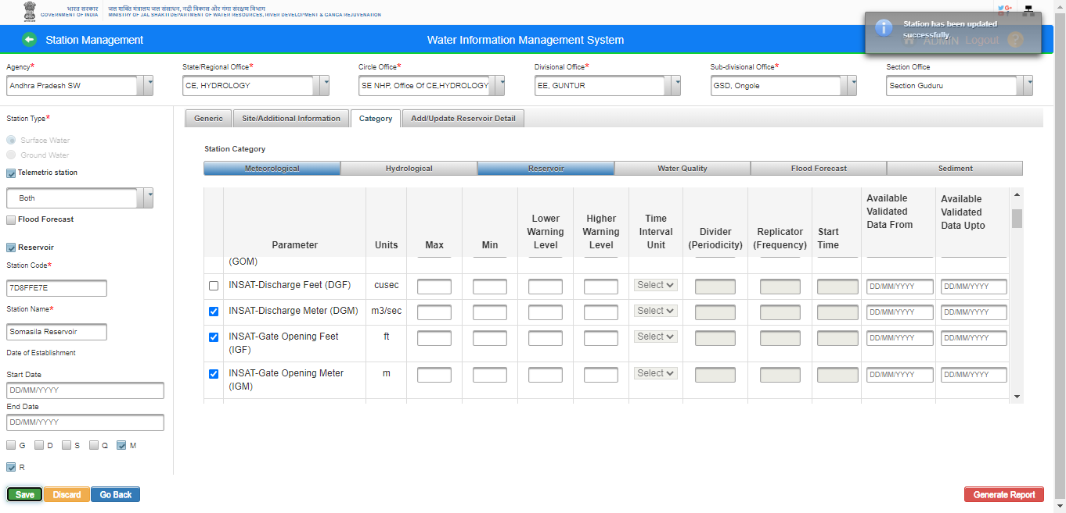
Sensor Mapping

Slide 28
How to configure the sensors on Reservoir Telemetry Sites in WIMS ?
Create Satellite Id Configuration
Add Gates Configuration
Edit Gates Configuration

Slide 29
Create Satellite Id Configuration

Slide 30
Add Gates Configuration

Slide 31
Edit Gates Configuration

Slide 32
Questions and Answers with Feedback

Slide 33
THANK YOU

